Slide 1
Convolution Neural Network Performance Analysis: CPU-optimized vs GPU-optimized
Team : Geetika Khanna & Archit Harsh
Group – 6
Github Repo

Slide 2
Introduction & Objective
Convolutional Neural Networks (CNNs) have become fundamental tools in computer vision, achieving state-of-the-art results in tasks like image classification, object detection, and segmentation.
However, training these complex models is computationally intensive, often requiring substantial processing power and time. This computational demand has driven the adoption of hardware accelerators, primarily Graphics Processing Units (GPUs), to make deep learning training feasible.
Objective:
Compare CNN training performance across Intel CPU, GPU (NVIDIA CUDA), and Apple Silicon (MPS)

Slide 3
Project Goal & Metrics
Goal:
Quantitatively assess comparative performance analysis of a standard CNN architecture trained for image classification on the MNIST dataset using five distinct execution backends:
A multi-core CPU optimized using Numba's Just-In-Time (JIT) compilation
An NVIDIA GPU accelerated via Numba's CUDA JIT
A multi-core CPU utilizing the standard PyTorch framework
An NVIDIA GPU accelerated via PyTorch's CUDA backend
An Apple Silicon GPU utilizing PyTorch's Metal Performance Shaders (MPS) backend
Metrics Evaluated:
Training time per epoch
Throughput (samples/sec)
Memory Usage (RAM/VRAM)
Test Accuracy

Slide 4
Methodology - Dataset
MNIST Handwritten Digits
It consists of of 60,000 28x28 pixel grayscale training images and 10,000 test images, representing digits 0 through 9.
Dataset Processing
Preprocessing :
Pixel values were normalized from the original [0, 255] range to [0.0, 1.0] by dividing by 255.0. For the PyTorch implementations, an additional normalization step using the dataset’s mean
Padding :
To ensure consistent batch processing and avoid handling partial batches, both the training and test sets were padded.
Data Loading :
For Numba implementations (CPU,CUDA), data was loaded into NumPy arrays using ‘tensorflow.keras.datasets.mnist‘
For PyTorch implementations (CPU, CUDA, MPS), data was loaded using ‘torchvision.datasets.MNIST‘ and ‘torch.utils.data.DataLoader‘, which handles batching and shuffling automatically.

Slide 5
Methodology - CNN Architecture
A consistent CNN architecture was implemented across all platforms :-
Input: (Batch, 1, 28, 28)
Conv1: 1 input channel, 8 output filters, 3x3 kernel, stride 1, ReLU activation.
MaxPool1: 2x2 kernel, stride 2. Output: (Batch, 8, 13, 13).
Conv2: 8 input channels, 16 output filters, 3x3 kernel, stride 1, ReLU activation.
MaxPool2: 2x2 kernel, stride 2.
Flatten: Output: (Batch, 16 * 5 * 5 = 400)
Dense1: 400 input features, 128 output units, ReLU activation.
Dense2: 128 input features, 10 output units.
Activation (Output): explicit Softmax (Numba) or softmax incorporated into ‘nn.CrossEntropyLoss’ (PyTorch)

Slide 6
Methodology - Implementation
Numba (CPU & CUDA):
Manual kernel implementation using Numba JIT (@njit, @cuda.jit).
NumPy for data structures.
Explicit parallelization (parallel=True for CPU).
Manual SGD+Momentum update (simplified backprop for FC layers only).
Numba CUDA: Explicit Host<->Device memory transfers; hybrid CPU/GPU execution.
PyTorch (CPU, CUDA, MPS):
Standard nn.Module for model definition (ConvNetPyTorch).
Leverages PyTorch DataLoader for batching/shuffling.
Uses built-in optimized layers (nn.Conv2d, nn.Linear, etc.).
Utilizes PyTorch Autograd for gradient calculation.
Uses torch.optim.SGD optimizer.
Device selection via torch.device('cpu'/'cuda'/'mps').

Slide 7
Methodology - Hardware & Software
Programming Language:
Python
PyTorch
Libraries Used:
NumPy: For numerical operations and data structures in Numba implementations.
Numba: For JIT compilation on CPU and CUDA.
TensorFlow: Used solely for ‘tf.keras.datasets.mnist‘ data loading.
Matplotlib, Seaborn, Pandas: Data loading and visualization
Psutil: For RAM logging
Hardware Environments:
CPU -> Intel Core Ultra 7 155H (22 CPUs)
GPU -> NVIDIA GTX 4060 (8GB DDR6 VRAM) (CUDA-enabled)
MPS -> Apple M4 Pro 16 core GPU (with Metal support)

Slide 8
Experiments
Setup:
Orchestrated by ‘main.py’ script.
Command-line arguments control platform selection (--platform) and hyperparameters (--epochs, --batch_size, etc.).
Hardware/software availability checked before each run.
Standardized Procedure (per platform):
Load/preprocess MNIST data.
Initialize model and optimizer/weights.
Train for a fixed number of epochs.
Evaluate on test set after each epoch.
Default Parameters:
Epochs: 10, Batch Size: 512, Optimizer: SGD (Momentum=0.9), Learning Rate: 0.01
Evaluation:
Capture and log metrics in separate ‘results/metrics_*.csv’ files.
Creates comparative plots.

Slide 9
Results
Platform | Avgerage Epoch Time (s) | Total Train Time (s) | Average Throughput (samples/s) | Final Test Accuracy (%) | Max Test Accuracy (%) | Average Process RAM (MB) | Max GPU VRAM (MB)
CPU (NUMBA) | 2.0928 | 20.928 | 30501 | 96.33 | 97.42 | 1334.572 | 0
GPU CUDA (NUMBA) | 0.9268 | 9.268 | 71758 | 96.68 | 97.56 | 1156.894 | 0
CPU (PYTORCH) | 11.2687 | 112.687 | 5340 | 97.57 | 98.5 | 1611.935 | 0
GPU CUDA (PYTORCH) | 8.7219 | 87.219 | 6948 | 97.21 | 98.5 | 1363.258 | 16.87
MPS (PYTORCH) | 9.0544 | 90.544 | 6645 | 97.31 | 98.5 | 1188.246 | 0

Slide 10
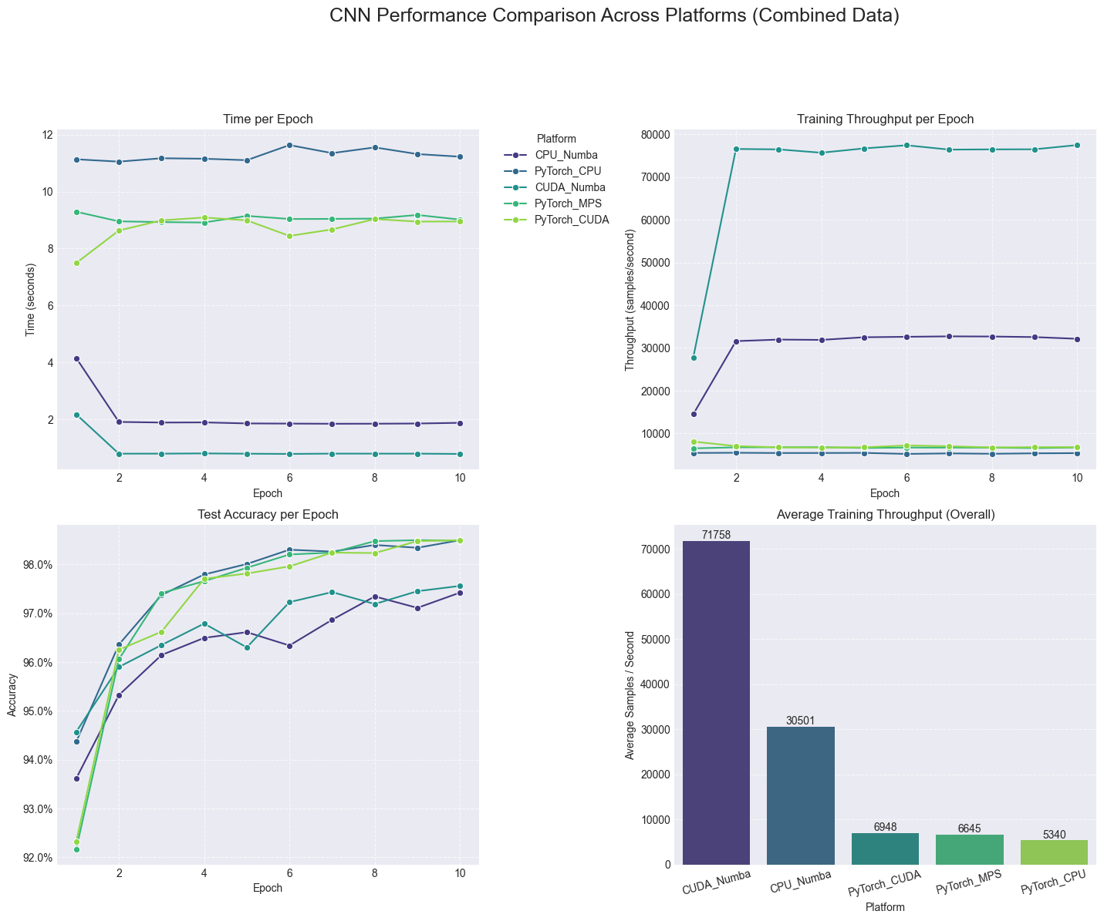
Performance Comparison Plot

Slide 11
Analysis – Speed & Throughput
Average Epoch Time (Lower is Better):
GPU Platforms: Significantly faster than CPU.
Numba CUDA: 0.93s (Fastest)
PyTorch CUDA: 8.72s
PyTorch MPS: 9.05s
CPU Platforms: Considerably slower.
Numba CPU: 2.09s
PyTorch CPU: 11.27s (Slowest)
Average Throughput (Higher is Better):
GPU Platforms: Process data much faster.
Numba CUDA: ~71,800 samples/s (Highest)
PyTorch CUDA: ~6,900 samples/s
PyTorch MPS: ~6,600 samples/s
CPU Platforms: Lower processing rate.
Numba CPU: ~30,500 samples/s
PyTorch CPU: ~5,300 samples/s (Lowest)

Slide 12
Analysis – Accuracy & Resources
Maximum Test Accuracy (Similar is Good):
All platforms achieved high accuracy: ~97.4% - 98.5%
PyTorch platforms (CPU, CUDA, MPS) reached slightly higher peak: 98.5%
Numba platforms (CPU, CUDA) peaked around ~97.5%
Takeaway: Backend choice did not significantly hinder model's learning ability.
Resource Usage (Snapshot):
Avg. Process RAM:
Highest: PyTorch CPU (~1612 MB)
Lowest: Numba CUDA / PyTorch MPS (~1160-1190 MB)
Numba CPU / PyTorch CUDA: Mid-range (~1330-1360 MB)
Max GPU VRAM:
PyTorch CUDA: ~17 MB reported
Others: N/A or Not Measured via this method

Slide 13
Conclusion
Performance:
The GPU CUDA implementation clearly outperforms all others in raw speed and throughput. It is ideal for real-time or large-scale training where speed is critical, though it may trade off some accuracy. The NUMBA (or other native libraries like cuBLAS) implementation was better than Pytorch potentially due to simplified backpropagation.
Accuracy:
PyTorch-based platforms (especially on CUDA and MPS) consistently achieve the highest accuracy, making them better suited for applications demanding reliable convergence and generalization.
Framework Impact (CPU)
On the CPU, Numba JIT provided a substantial speedup compared to the standard PyTorch CPU backend. This showcases Numba's strength in accelerating numerical Python code on multi-core CPUs through compilation and parallelization, outperforming PyTorch's default CPU execution strategy for this specific model and implementation.
Efficiency:
GPU CUDA (NUMBA) offers the best speed-to-resource usage ratio, while MPS (PyTorch) offers a great balance between speed, accuracy, and efficient resource utilization—especially useful on Apple devices.
Recommendation:
For performance-critical deployments, go with GPU CUDA (NUMBA or other native libraries like cuBLAS).
For high-accuracy models and simplified abstraction, prefer PyTorch (CUDA or MPS).

Slide 14
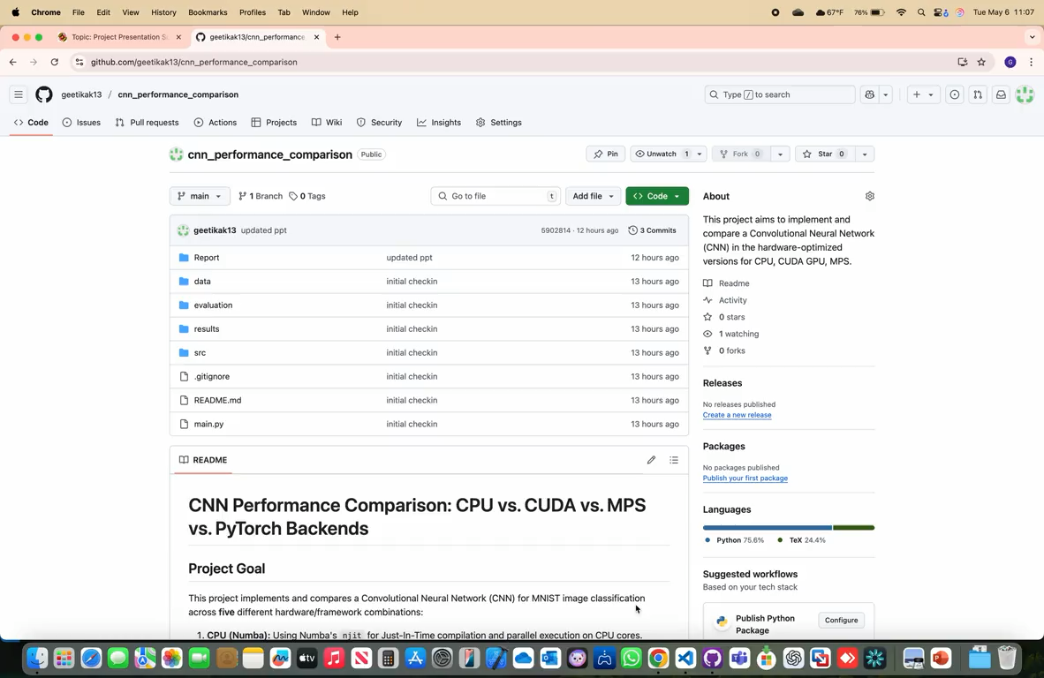
Video Demonstration of code

Slide 15
Literature References
Key References:
1. Krizhevsky, Sutskever, & Hinton (2012) – ImageNet Classification with Deep Convolutional Neural Networks
2. Sze, Chen, Yang & Emer (2017) – Efficient Processing of Deep Neural Networks: A Tutorial and Survey
3. Hubner, Hu, Peng & Markidis (2025) - Evaluating the Apple Silicon M-Series SoCs for HPC Performance and Efficiency

